Slide 1

Urban95:
Perspectives from Bhubaneswar’s Smart City Strategic Plan
Dr Krishan Kumar
Vice Chairman
Bhubaneswar Development Authority

Slide 2
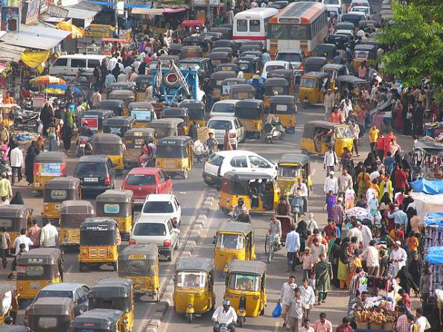
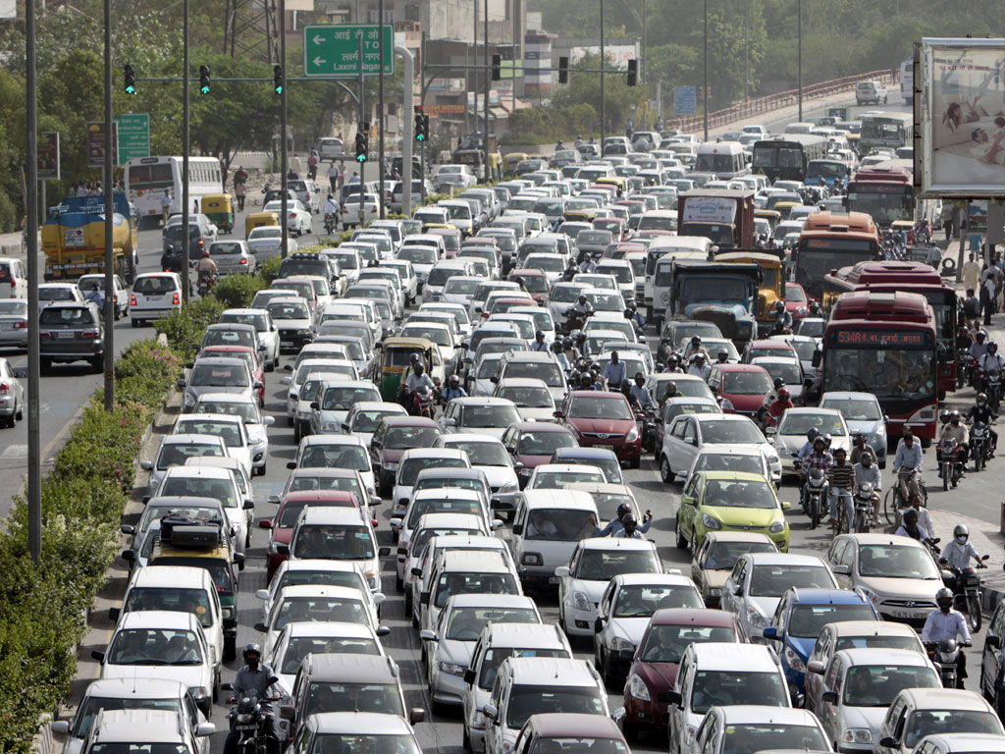
Current Development Trends

Slide 3
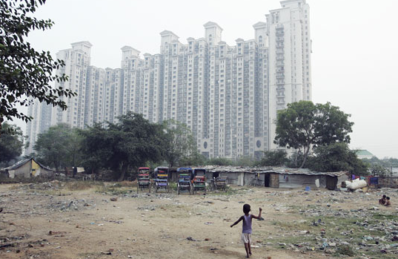
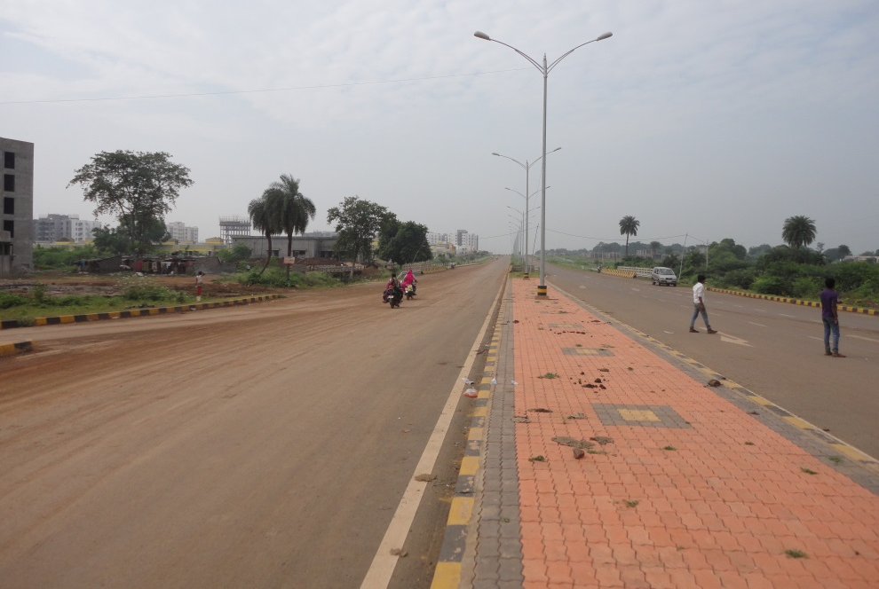
New Suburban Cities

Slide 4
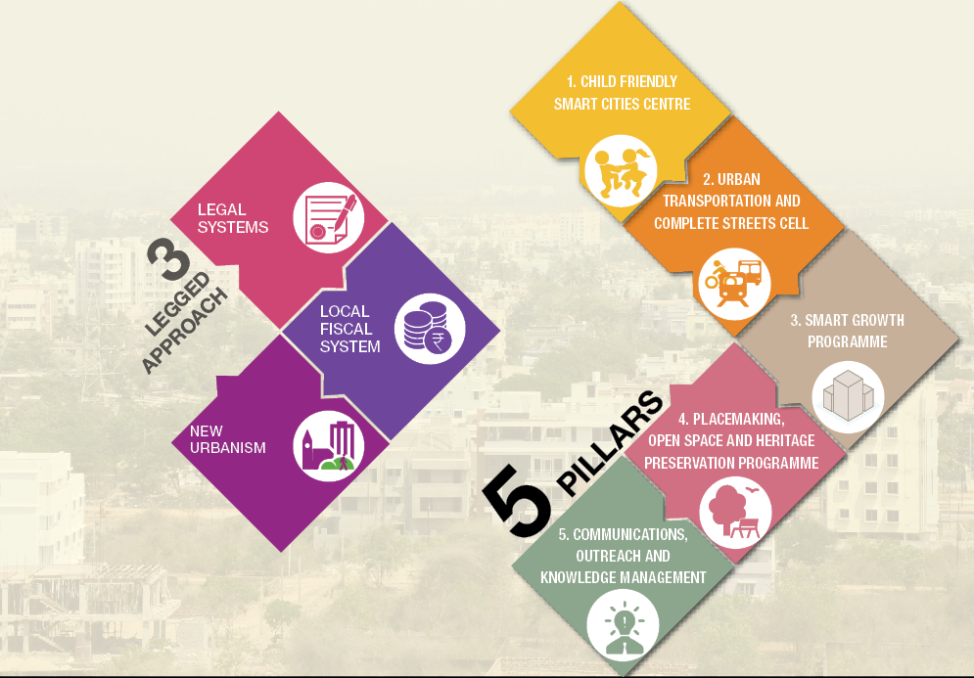
Need for a Paradigm Shift
New Urban Agenda
…from isolated project designs to systems-based approach

Slide 5
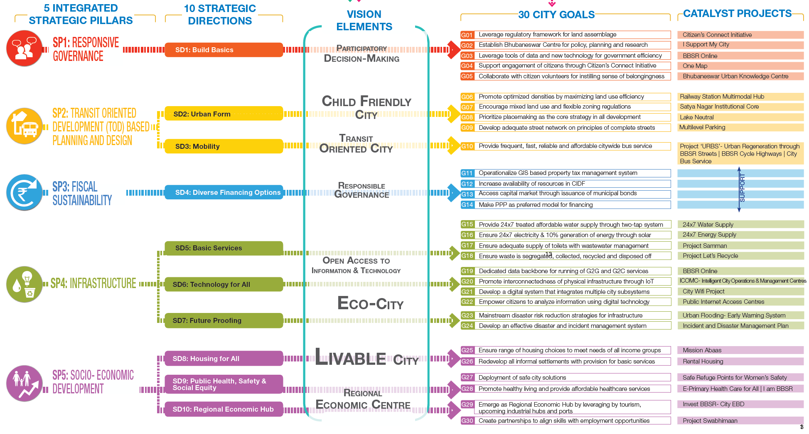
Reorienting City Systems: From Part to Whole

Slide 6
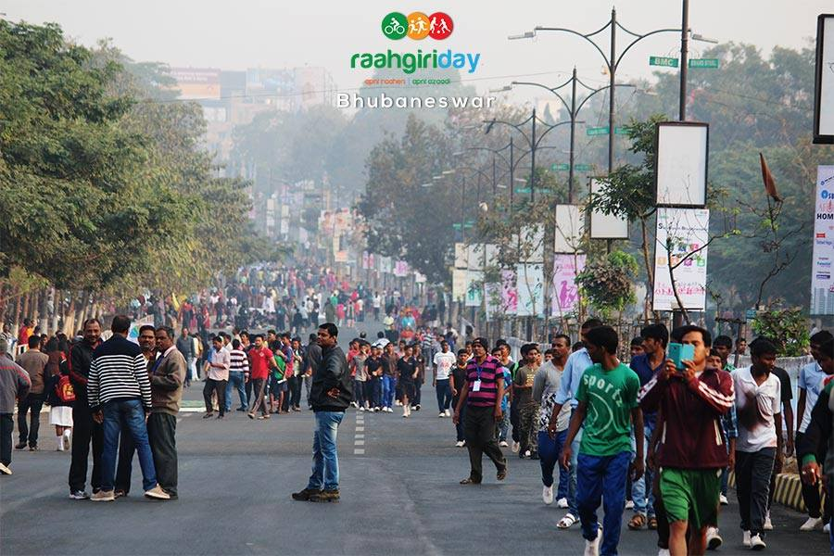
Bhubaneswar’s Smart City Strategic Plan
TRANSIT ORIENTED CITY
Compact urban form and sustainable mobility choices
LIVABLE CITY
Range of housing while enhancing its heritage
CHILD-FRIENDLY CITY
Accessible, safe, inclusive public places
ECO-CITY
Resilient, clean, green and healthy environment
REGIONAL ECONOMIC CENTRE
Knowledge based enterprises and sustainable tourism

Slide 7
PROJECTS UNDERWAY
Child Friendly Infrastructure
Communication & Knowledge Management
67 Playgrounds @ 1 per ward
12 Traffic Signals near schools
10 Public Kiosks with information panels
10 City Buses
4 redeveloped informal settlements
Press Briefs
Panel Discussions
Website
IEC Campaign
Capacity Building of key government stakeholders
Every year—4 batches
(25 participants)—3days
Child friendly component in planning documents
Disseminating knowledge through workshops
4 Seminars & 2 lectures every year
2 city level and 1 state level consultation
Annual Conference
Form based Urban Codes
Update existing plans
Notes:
Connect with the other 4 domains: reorganize the deliverables

Slide 8
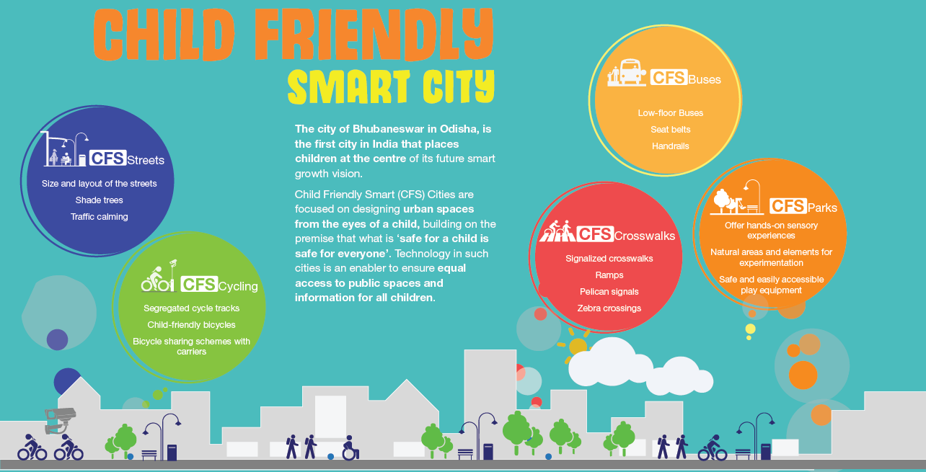
BDA: Applying Research into Child Friendly City Design

Slide 9
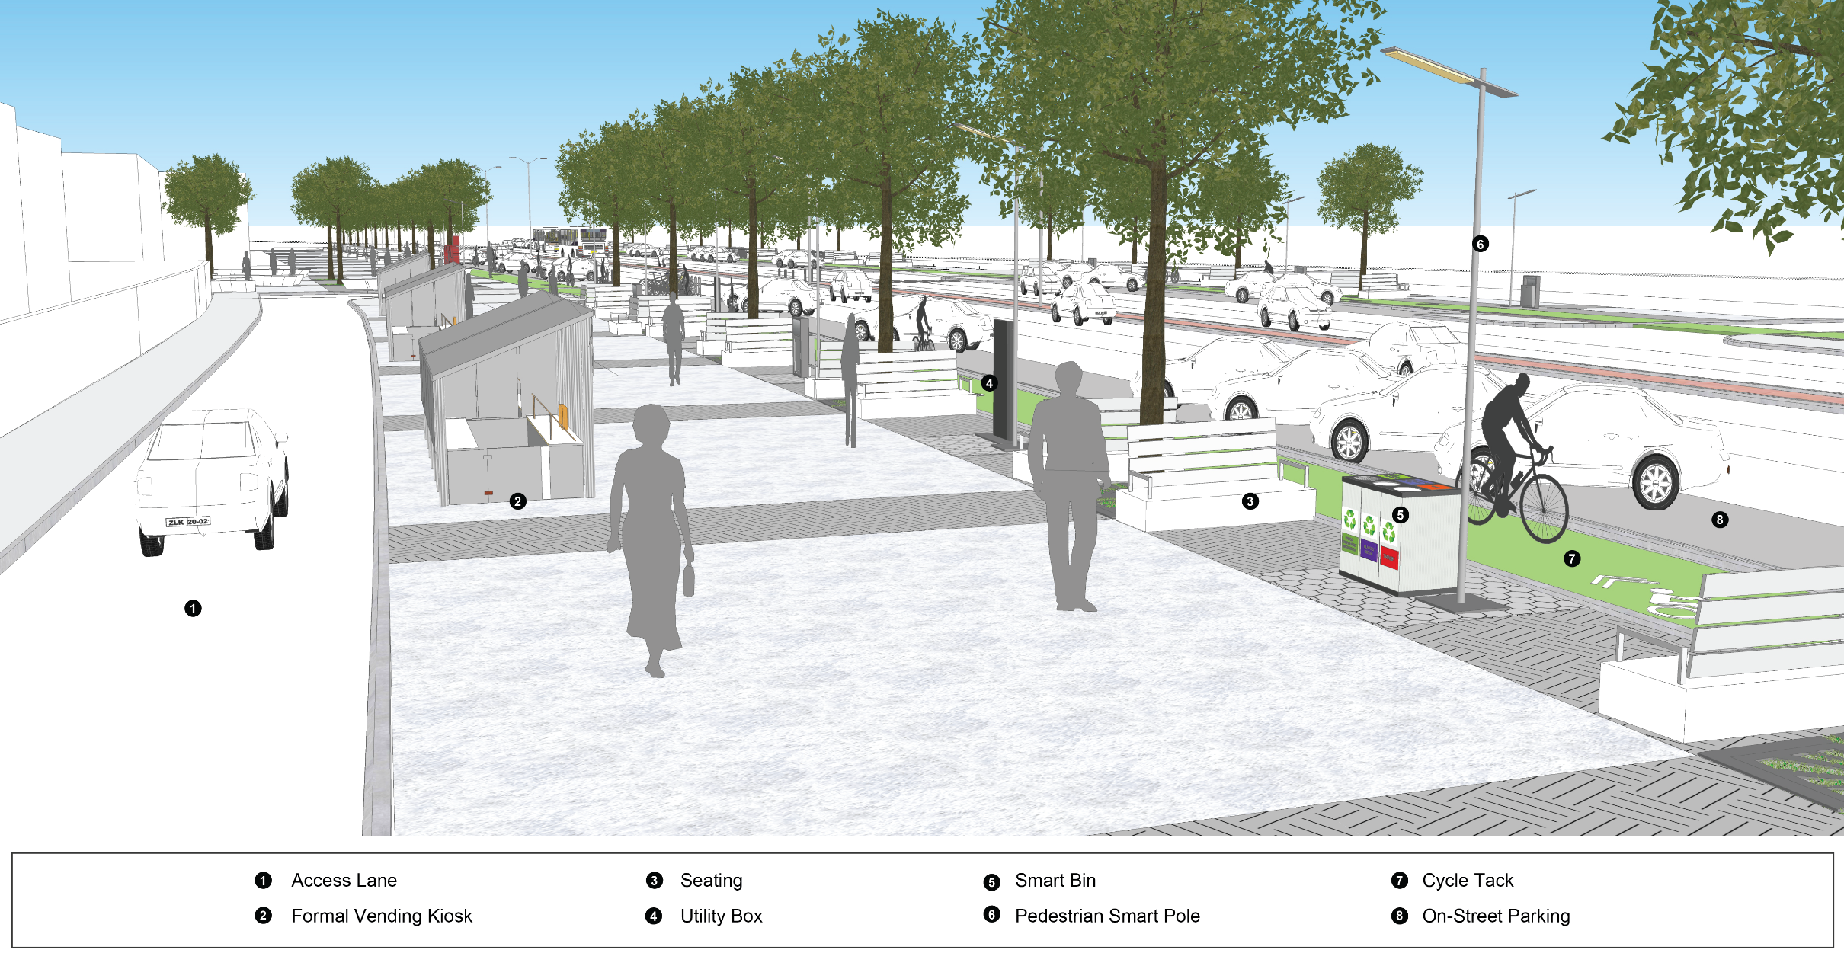
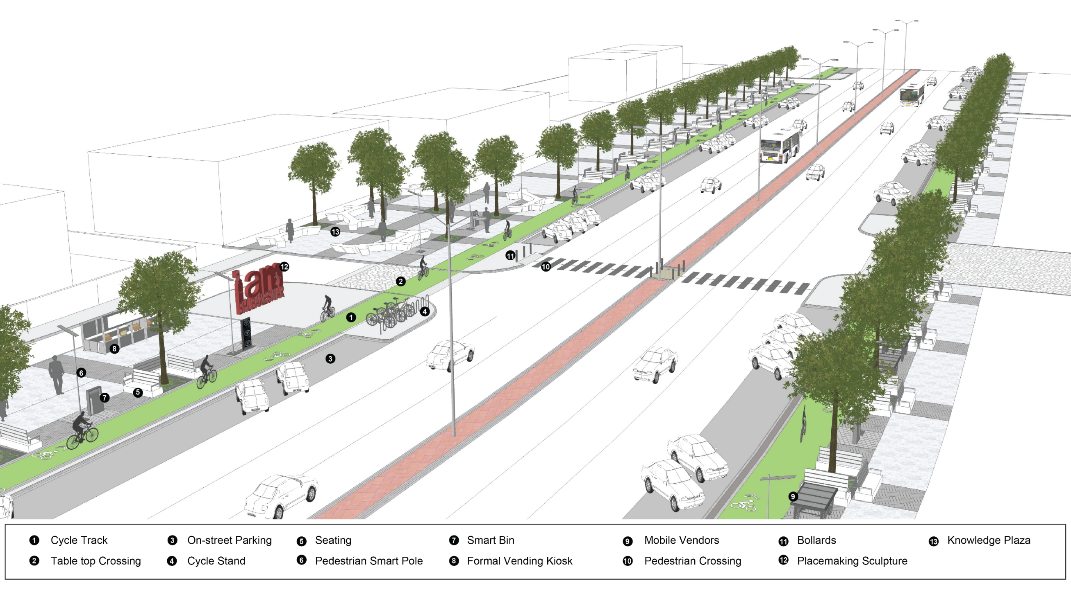
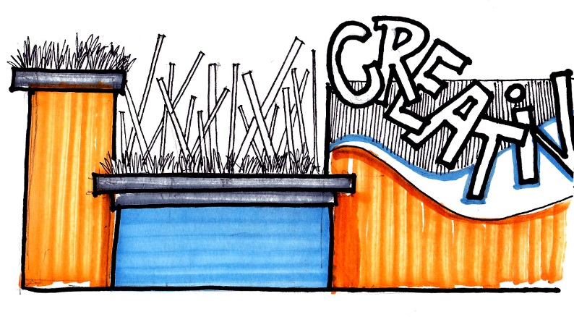
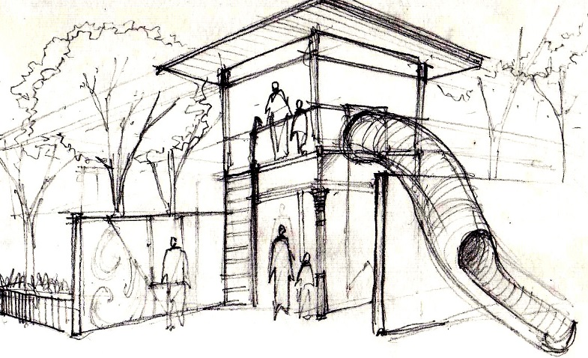
Upcoming Smart Projects
Smart Janpath
Smart Parks
EWS Housing

Slide 10
STRATEGY- KEY INTERVENTIONS
Upcoming Smart Projects
Policy Interventions-Review of statutory master plan | Review of town code
System Interventions- CFSC | Knowledge management | capacity building| Standard designs
Outreach Interventions- Community volunteers | Professionals
Environmental Interventions- Housing projects | playgrounds | traffic & transport

Slide 11








IMPLEMENTATION THROUGH PARTNERSHIPS
66
52
26
Low income neighbourhoods
Child clubs
Child led planning
2035
260
Child club members
Child leaders
43
61
School interventions
Anganwadis

Slide 12
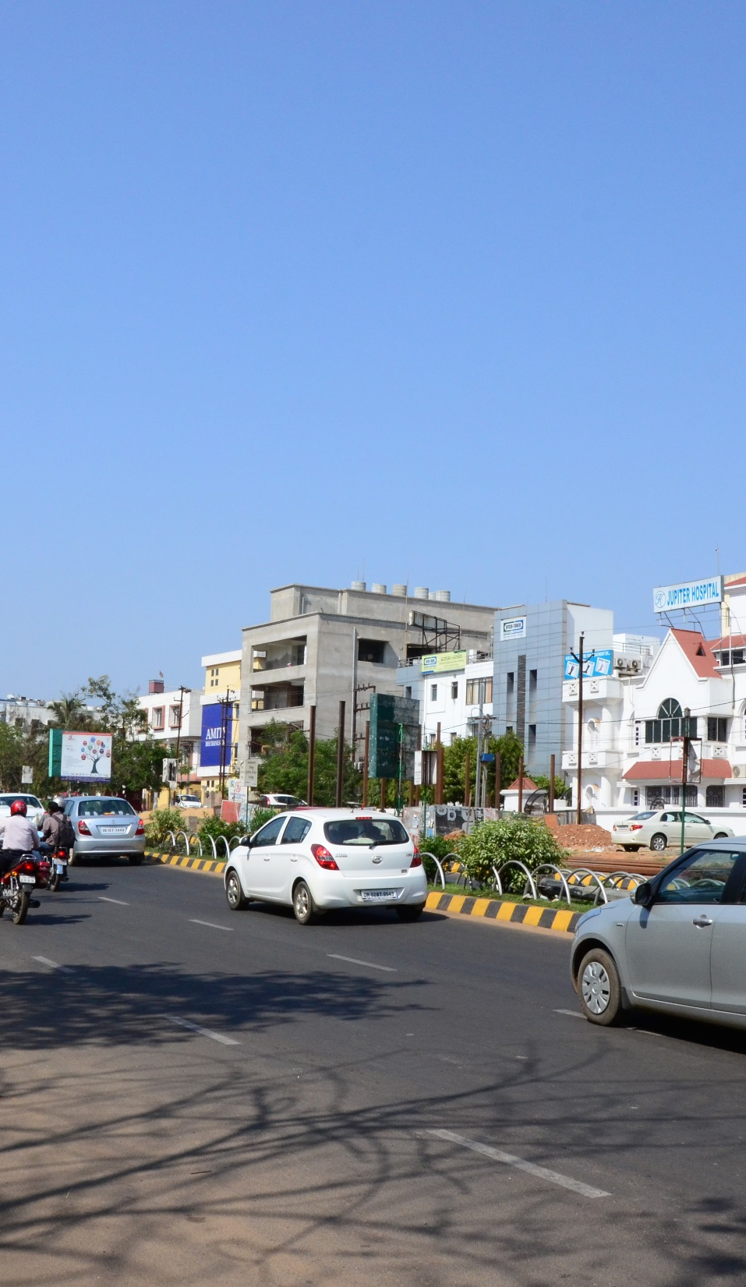
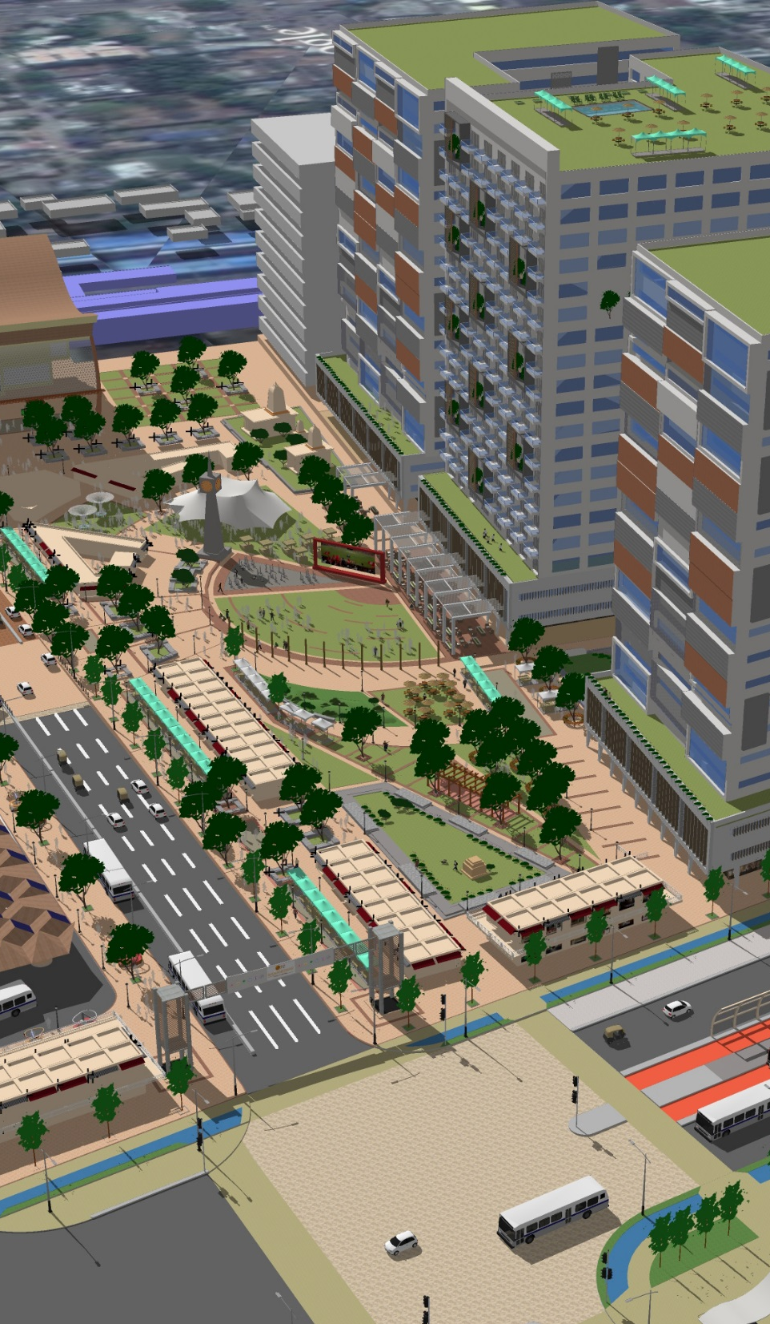
THANK YOU

